Slide 1
Acceleration Programme 2023
2023年
Corporation Development Division
Incubation & Acceleration programmes
FOR INFORMATION

Slide 2
HKSTP Incubation and Acceleration Programmes
Fit the needs for different stages of Startups
INCUBATION
(General & Bio-focused)
IDEATION
ACCELERATION
Formation
PRODUCTIZATION
&
COMMERCIALIZATION
SCALE-UP
Kick start your business with our support and expertise
From ideas to business readiness
Nurture tech start-ups to develop & commercialise solutions for market success
A business focused accelerator for growth stage tech ventures to expand onto the world stage

Slide 3
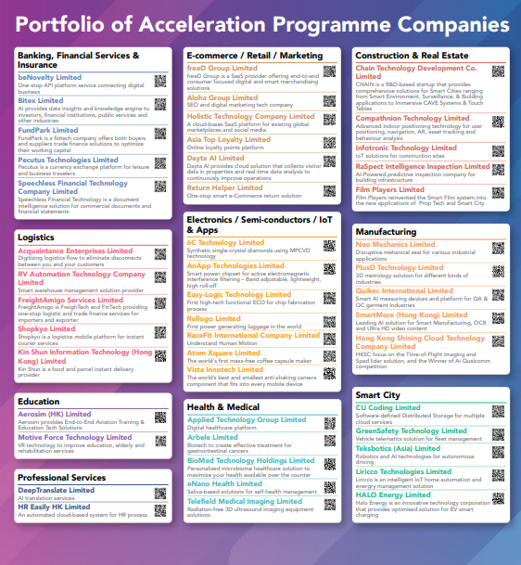


Powerhouse of Startups‘ Growth Engine
Our Mission & Sucessful Results
Our Success Metrics
Since 2018
Vision & Mission
Accelerate Later-stage
tech ventures
With our
Quality resources
Bringing our Acceleratees to
Achieve higher level
And become
Globally / Industrially recognized
USD1.7B+ Valuation
Overall AP Portfolio
USD290M+
Fund Raised
Max. 20X
Revenue Gain@1 Year
54+
Significant Growth
in Revenue
1 Unicorn
3 Acquired

Slide 4


Are these your next growth targets?
Do you possess the below?
Market validated product / solution
Solid business traction
Recurring revenue
Scalable business model
Solid plan to grow
Are these your next growth targets?
BD and market expansion
Revenue growth and profitability
Value building & growth financing
Become a household name
Exit / IPO

Slide 5

Together, Make it better,
Acceleration Programme
is your right way to go!

Slide 6
Our Objectives
Growth, Scale Up & Expand
2 yrs In Prog.
Growth in Revenue & Valuation
In 5-7 yrs
Regional/Global player & Exit
“Revenue Jump”
100%+ YoY revenue
Successful fundraising
40% of revenue outside HK
10% of company exited by M&A /IPO
Significant Growth in Business and Valuation
BUSINESS
Revenues (HKD)
5M > 10M > 30M > 50M+
VALUATION
>
>
Pre-Ponies
> US$1M and <US$10M
Pre-Centaurs
> US$10M and <US$100M
Pre-Unicorns
> US$100M and <US$1B

Slide 7
Expedite Growth & Expansion
We Understand Your
Next-Level Needs
Resources
Network & People
HKSTP:
Your Partner & Stakeholder

Slide 8
New acceleration scheme Summary
HK$3.6M milestone grant payment
1.2M
3.6M
HK$1.2M credit for domain expert retainer
4.8M HKD

Slide 9

Milestone target guide
Applicants propose 3-5 milestone targets which will significantly impact business/valuation in the next two years.
All milestone targets should be qualifiable with proof evidence
Short Term
Business
Market penetration
Market expansion/business from new regions
Customer
new customer sectors / customer growth / reputable customer
Mid Term Target
Finance
Revenue
Total revenue (LTM) / recurrent revenue (MRR/ARR)
Fundraising
CB / equity investment /
Long Term Target
R&D
Product
New product / Platform
IP
Total patents filed / approved
3.6M

Slide 10
Milestone based grant payment flow
No target timeline for millstone completion. Grant payment upon completion
300K HKD upon completion
900K HKD upon completion
Probation
Period
Short Term
1.2M HKD upon completion
Mid Term Target
1.2M HKD upon completion
Long Term Target
Take example of a SaaS company
Short Term
Product – New features launch with proofed new revenue stream (upsell)
Mid Term Target
Revenue - MRR reach to 500K USD (100% growth)
*Sample description is for explanatory purposes only
Milestone target detail description is required
Long Term Target
Customer - Annual Retention Rate hit 110%
3.6M

Slide 11

Values
beyond Money

Slide 12


Expedite Your Growth & Expansion
Network & People
Expedite Growth & Expansion
Resources
HKSTP: Your Partner & Stakeholder
Business Development
Growth Management
Acceleration Team as business advisor & resource connector.
Domain experts and business veterans to help to fuel your business growth.
Industry mentorship system & connections.
Anchor sales – channel building & scale-up and expansion in regional/ global markets.
Acceleration Team as financial advisor. Get you ready and support your transaction in fund raising.
Equip you with knowledge and skills needed in next stage. Get your team well prepared.
Strategy review on IP, corporate development and capital planning. Corporate & HR structuring. Marketing & PR.

Slide 13



































Business Development
Giving you wings to fly and accelerate your growth globally
Business Development
Matching & Adoption
Domain Expert / Professional Service
Networking & Insight
Investment
Business matching
Solution adoption (PSTS, PTS)
First @ SP and PoC @ Smart Campus
Domain expert to fill your gap when you grow
Professional services firms in legal, IP, IT, finance, business / technical consulting etc.
Connections to industry leaders, CXO 1-on 1
Connection to partnership team, with 8 focus areas
Regional /overseas expansion
Tradeshow, training, event etc
Marketing & promotion
Channel building

Slide 14



Capital Management
Prepare your financial needs for your growth
Investment
Funding
Guidance
Financial planning
Capital restructuring
Prepare for your Fund Raising
Connection to HKSTP funding, Short term loan
Access to government support and funding
Investment pitch & matching
Guidance during your fundraising process
Capital management strategy

Slide 15
Expedite Growth & Expansion
We Understand Your
Next-Level Needs
Resources
Network & People
HKSTP:
Your Partner & Stakeholder

Slide 16
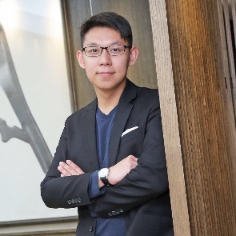
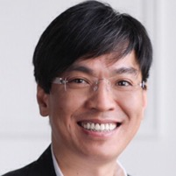
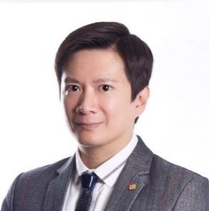
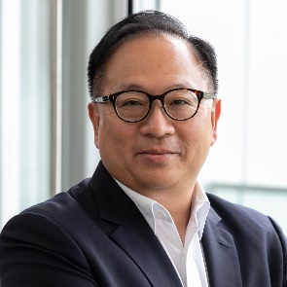
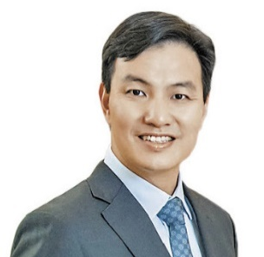
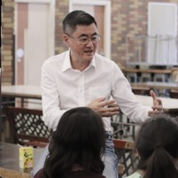
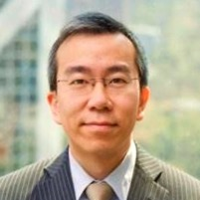
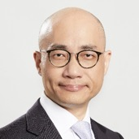
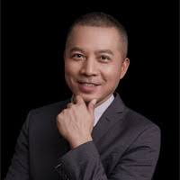
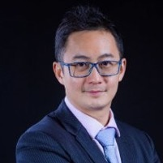
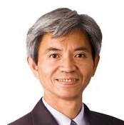
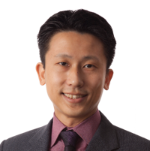
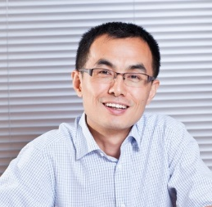
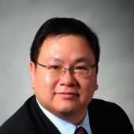
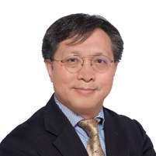
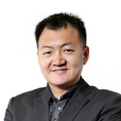
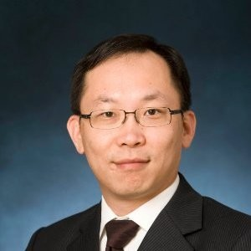
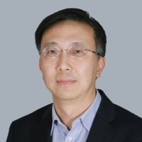
Mentors and Advisors
Network & People
Expedite Growth & Expansion
Resources
HKSTP: Your Partner & Stakeholder
Alexander Chan
Co-Director of
The Mills Fabrica
Henry Chan
Principal of Epiphani and former President, Greater China of Landor Associates
Dr. Jason Chan, JP
Chairman
Totaltact Network and Advisory Committee Member of ITVF
Dr. Toa Charm
Associate Professor,
Business School, CUHK, Chairman of OpenCertHub, Former CPMO of Cyberport
Choy Chi Fai
Chairman &
Co-Founder of Ausupreme International Holdings Ltd (Stock Code 2031.HK)
Prof. Joseph Koc
Adjunct Associate Professor of HKUST Business School and former Group Marketing Director of Jardine OneSolution Group
Thomas Kwan
Managing Director of Odysseus Capital Asia and former Director, Corporate Finance of PwC
Ivan Lam
Director of Strategy, ASTRI
Steve Lau
Founder
China Fortune Holdings Ltd. and former Chairman of Fortune Telecom Holdings Ltd.
Donald B Ma
Executive Communications & Sales Force Development Facilitator
Timothy Ma, JP
Vice Chairman of Hong Kong General Chamber of Social Enterprise Limited and former Executive Director of Senior Citizen Home Safety Association
Edward Poon
Chief Operating Officer of Human Health (Stock code 1419.HK)
Dr. Zhang Yong
CEO & Founder of Inspiration Capital
Dr. Charleston Sin
Executive Director of MIT Hong Kong Innovation Node and former Managing Director, Greater China,
Cisco System
Dr. Samson Tam, JP
Partner of Hong Kong
Inno Angel Fund and Chairman of Group Sense Limited (Stock Code 601.HK)
Dr. Miles Wen
Founder & CEO
of Fano Labs
Mr Ronald Wong
General Manager, Hong Kong and Macau of Lenovo
Zhu Jian Huan
VC/ PE/ start-up Advisor, former Venture Partner of IDG Capital

Slide 17
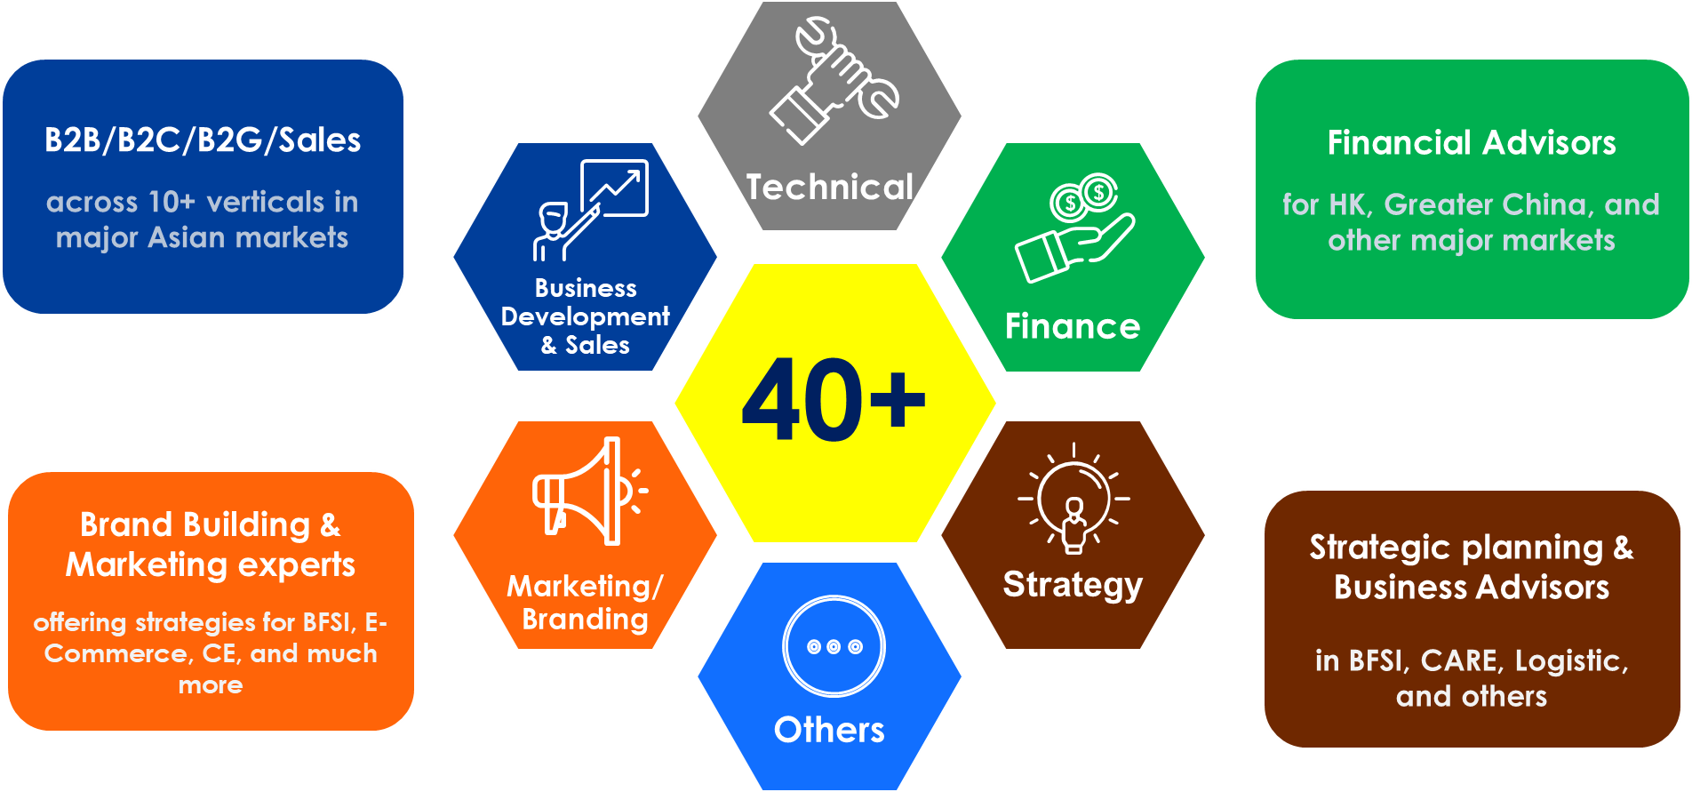
Domain expert
Domain expert can be selected from HKSTP domain expert pool (continue expanding)
Or
Company nominates candidates to enter the domain expert pool
Nomination
Application Form + CV
Interview by HKSTP Acceleration Team for approval
Onboard
Sign agreement with company
Payment conducted by HKSTP
1.2M
*Monthly salary > 50K require HKSTP preapproval
*Maximum engagement period no longer than 12 months

Slide 18



HKSTP as your
partner and stakeholder
(SAFE)
Simple agreement for future equity
Qualified Equity
Financing Round:
US$2M or 5% Equity
HKSTP convert at HK$4.8M based on next round valuation
Qualified Equity
Financing Round
Valuation

Slide 19
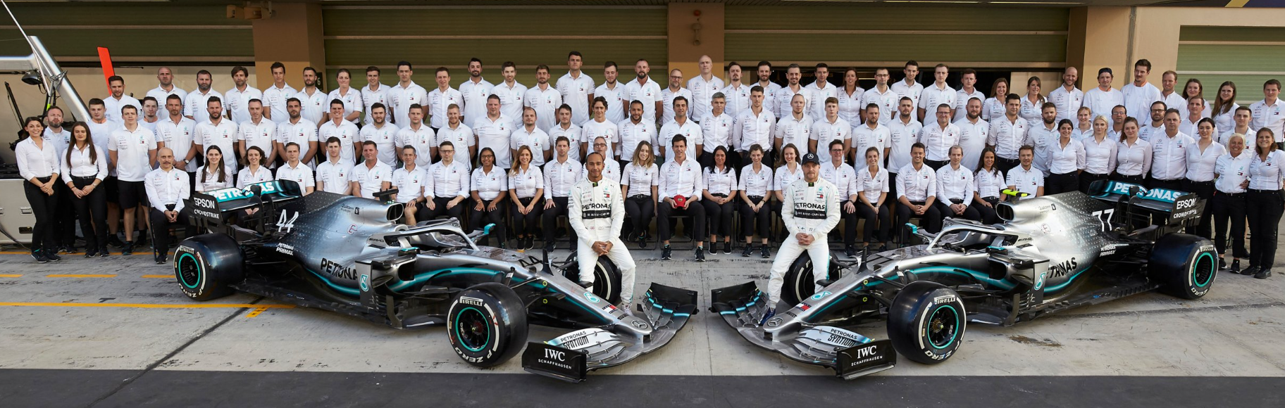
The success of our Partner Companies is our success

Slide 20


TO INFINITY AND BEYOND
Skyrocket Your Valuation
Become the World’s Household Name
For enquiries, please email to acceleration@hkstp.org

